Slide 1

The Machine Learning Process
What do I need to know about
the pandas index? (Part 1)
Reza Dibaj

Slide 2
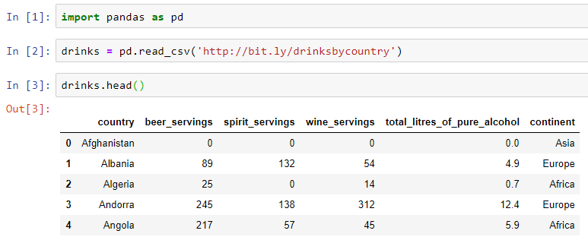
Knowing more about the index
Let’s pull up an example dataset as follows:
Notes:
import pandas as pd
drinks = pd.read_csv('http://bit.ly/drinksbycountry’)
drinks.head()

Slide 3
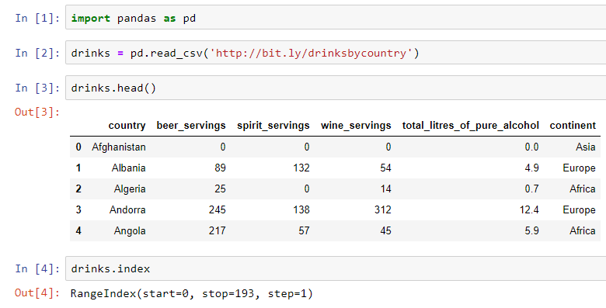
Knowing more about the index
Every DF has indexes that are also called row labels.
Notes:
drinks.index

Slide 4
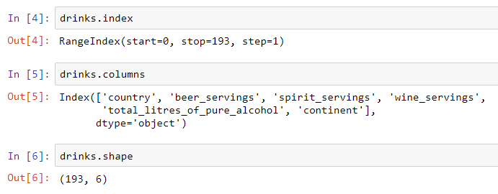

Knowing more about the index
The column headers are not part of THE indexes.
Neither column headers, nor indexes are part of the DF.
Notes:
drinks.index
drinks.columns
drinks.shape

Slide 5
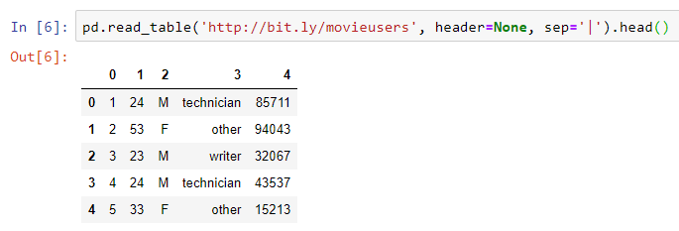
Knowing more about the index
Neither column headers, nor indexes are part of the DF.
The 0, 1, 2, 3, … are the default values for both column headers and row headers (indexes).
Notes:
pd.read_table('http://bit.ly/movieusers', header=None, sep='|').head()

Slide 6
Knowing more about the index
Why does the index exist?
Identification
Selection
Alignment

Slide 7
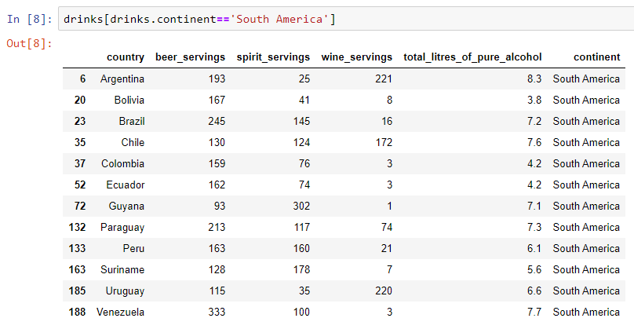
Knowing more about the index
Identification: The indexes kept their original row numbers.

Slide 8
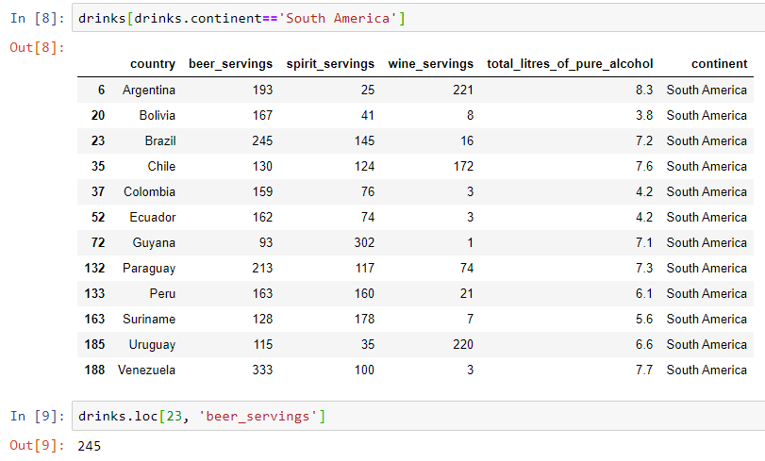
Knowing more about the index
Selection: The following is how we select a specific row or specific rows:
Notes:
drinks[drinks.continent=='South America’]
drinks.loc[23, 'beer_servings']

Slide 9
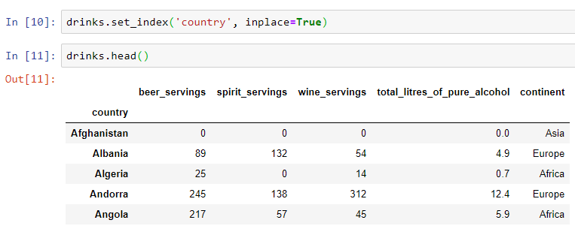
Knowing more about the index
Why using index and not using a column instead?
Index Name
Notes:
drinks.set_index('country', inplace=True)
drinks.head()

Slide 10
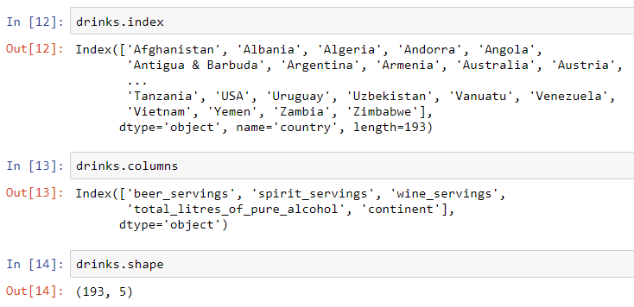
Knowing more about the index
Why using index and not using a column instead?
Notes:
drinks.index
drinks.columns
drinks.shape

Slide 11

Knowing more about the index
How to access a row, using the new index…
Notes:
drinks.loc['Brazil','beer_servings']

Slide 12
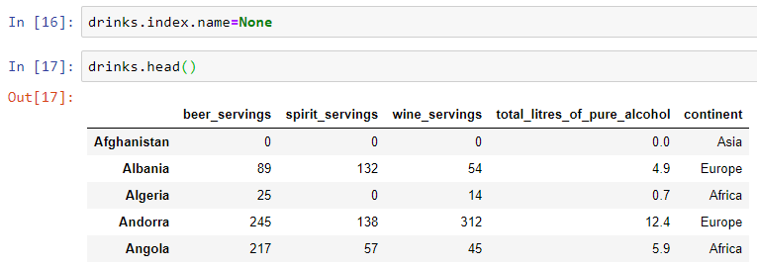
Knowing more about the index
How to delete the index name…
Notes:
drinks.index.name=None
drinks.head()

Slide 13
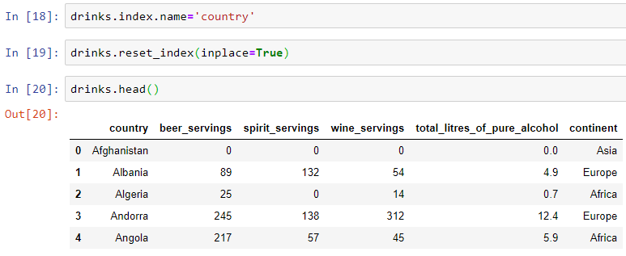
Knowing more about the index
How to reverse the procedure and bring back the current index into a column and set the conventional row index again.
It is important to set the name of the index before the reset process as this is the way that pandas decides the role of that column.
Notes:
drinks.index.name='country’
drinks.reset_index(inplace=True)
drinks.head()

Slide 14


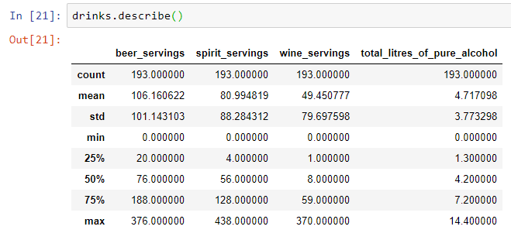
Bonus Tip
Let’s review a numerical summery of numerical columns.
Notes:
drinks.describe()

Slide 15
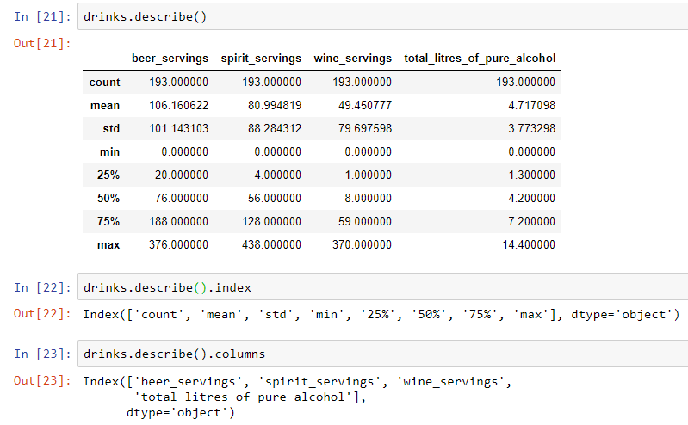
Bonus Tip
And the output of the command is a DF.
And it has its index and columns as well!
Notes:
drinks.describe()
drinks.describe().index
drinks.describe().columns

Slide 16

Bonus Tip
And simply we can apply all we did on a DF before, such as fetching a specific item as follows:
Notes:
drinks.describe().loc['25%', 'beer_servings']

Slide 17

Thank you
Question?
To be
Not to be

